Slide 1



DXC REAL TIME PROJECTS
Presented By: Mohana Likhitha(DXCAB1219)

Slide 2
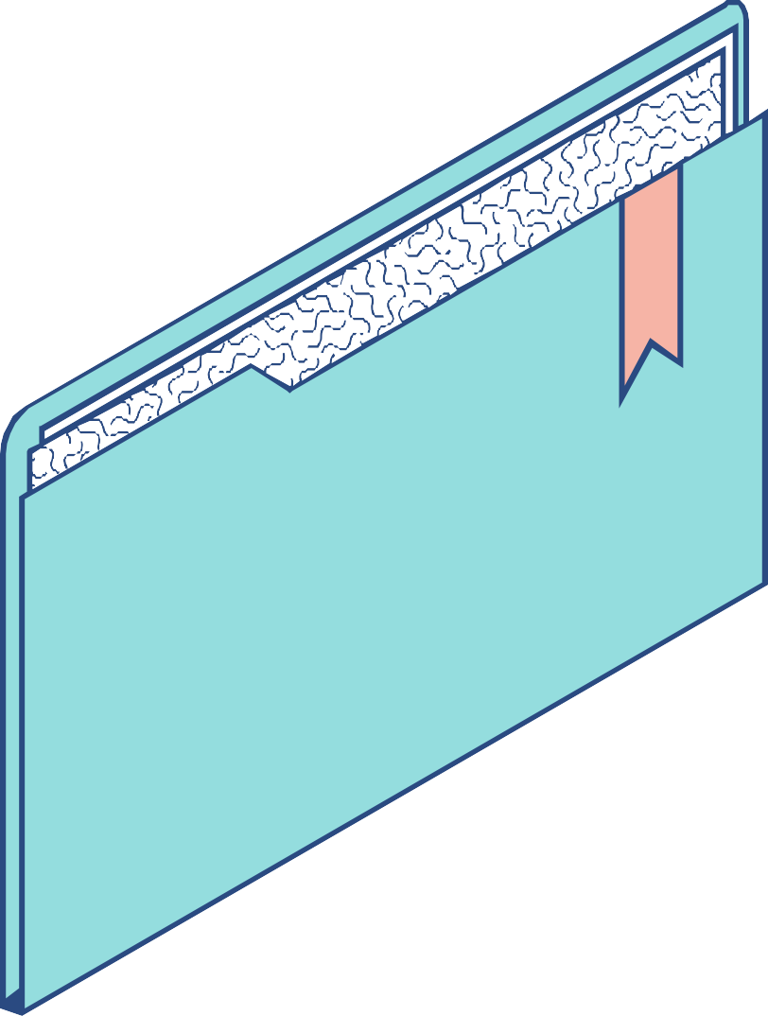
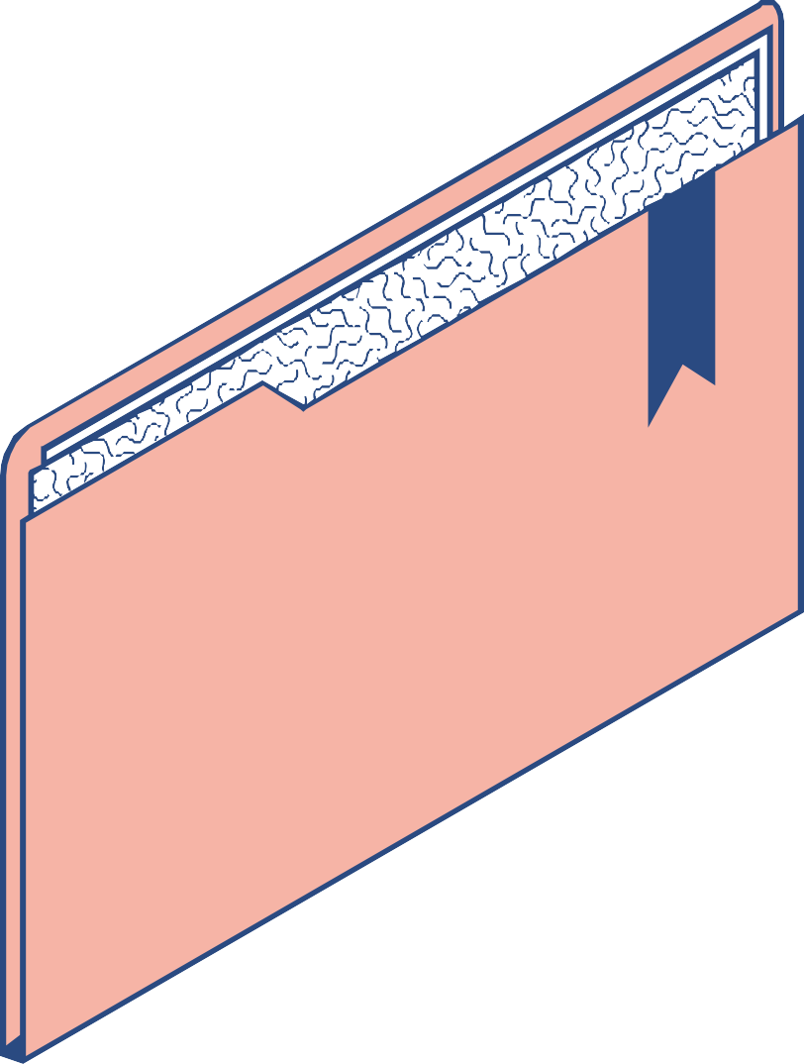
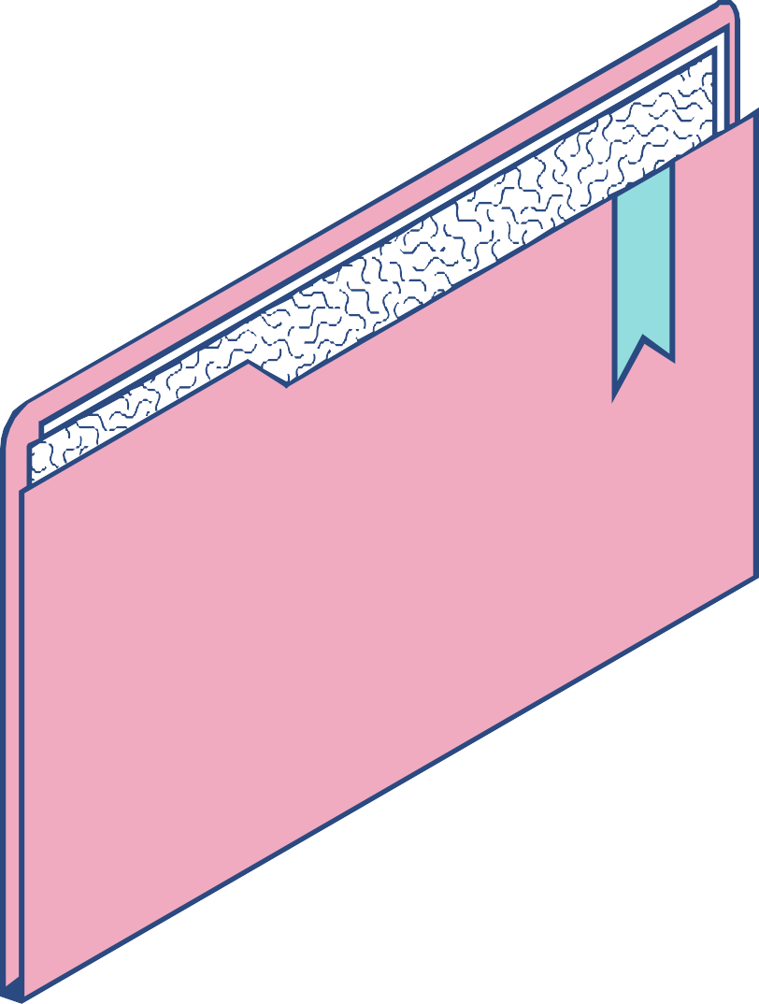
The Project is All About?
What is the Project 1 about? How to tend to the project 1? What can be achieved from Project 1? What is the Project 2 about? How to tend to the Project 2? What can be achieved from Project 2?

Slide 3
Project 1
Connected Vehicles
Basically, the real-time Connected Vehicles project of the General motors is, tracking the whereabouts and driving patterns of the drivers. They have introduced On-Star, their product which is a part of the connected vehicles project and this made sure not to connect the Driver’s personal details to the data that is being transmitted.

Slide 4
What is Project 1 About?
The Project one is about smart vehicles or connected vehicles. Here, we need to build an architecture to attain the connected vehicles.
What exactly need to be done here:
The vehicle has a third party IOT device which will send the data to AWS cloud in JSON format. We need to move the data from the third party AWS to the company's Azure cloud.

Slide 5


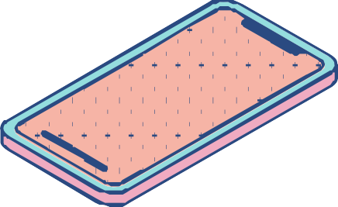

IoT Device | AWS Cloud | Azure Cloud
An IOT device is more like a sensor we are using with the vehicle which here is being used as the data transmitter. | It is an on-demand cloud computing platform which provides the users with many APIs. | Azure cloud is also similar to the AWS cloud, but comparatively, Azure cloud is much more flexible which makes it easier for us to work on our project.

Slide 6
What do we need to do in this Project ?
1
2
3
4
5
S T E P
S T E P
S T E P
S T E P
S T E P
Creating azure data factory
Creating Azure data factory pipeline
Creating blob trigger logic
Creating azure sql server and database
Adding another pipeline to move data from staging to sql database

Slide 7
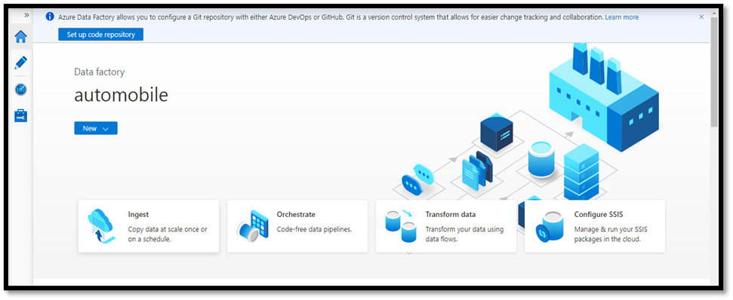
Creating Azure Data Factory (ADF) :

Slide 8
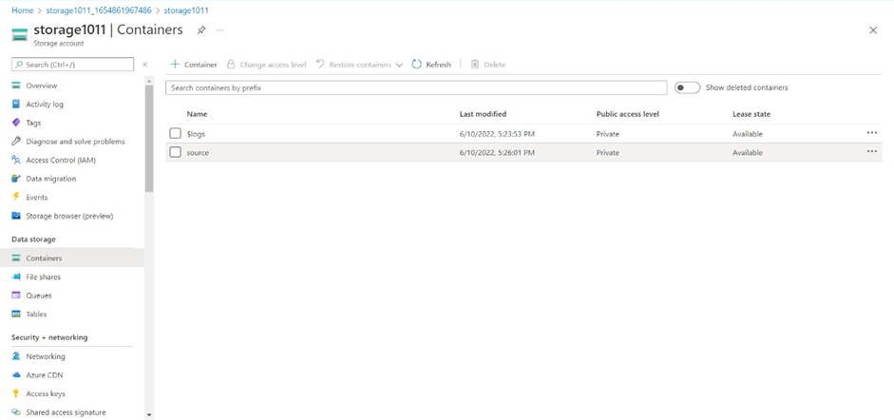
Create an Azure Storage Account with source container and destination container.

Slide 9
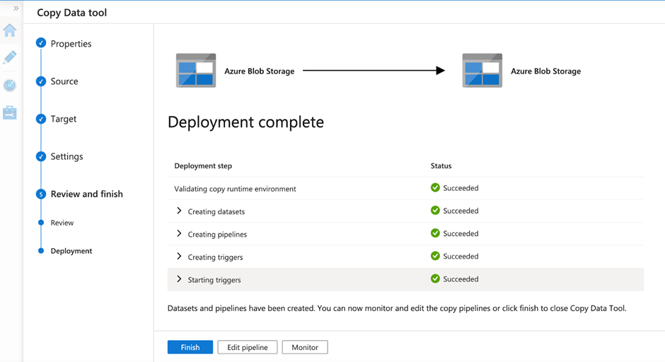
Pipeline has been created.

Slide 10
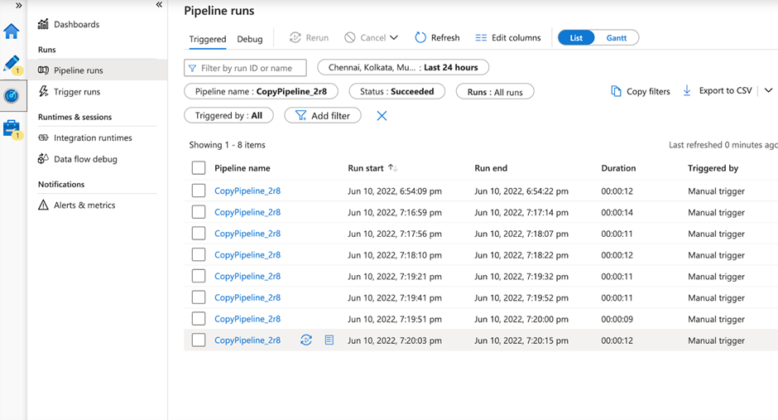
Creating a Blob Trigger

Slide 11
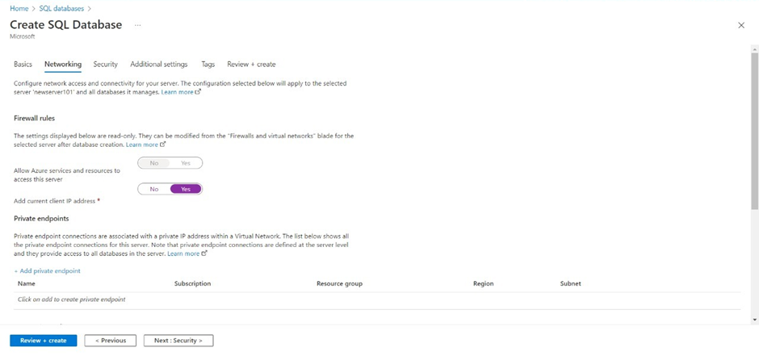
Create SQL server and SQL Database

Slide 12
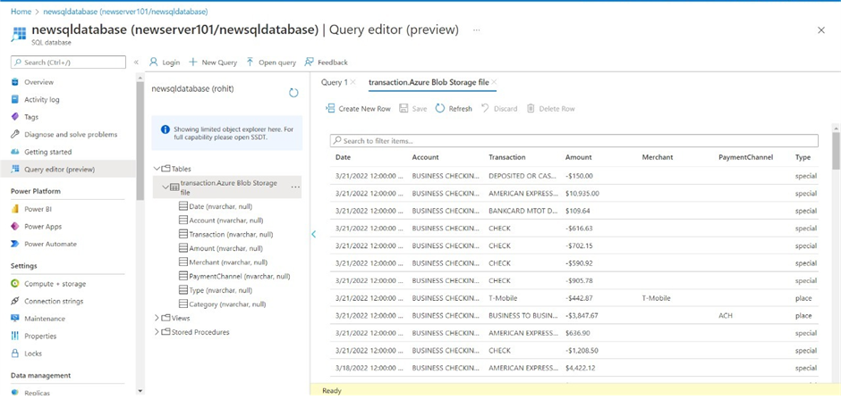
Create another pipeline to move the third-party data to the SQL database.
To check the result, Navigate towards the SQL database and check for the data.

Slide 13
Conclusion
Using the Azure Data Factory, we created a pipeline that will validate and copy the Blob data into the SQL database in this project.
The Blob data has been validated and stored in the SQL database

Slide 14

Industry Application of the project:
Smart City
Networks
Bi-directional communication
Mobility Sensing

Slide 15

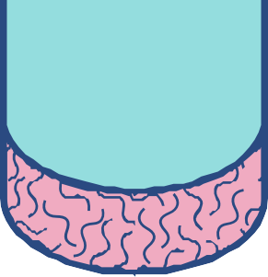

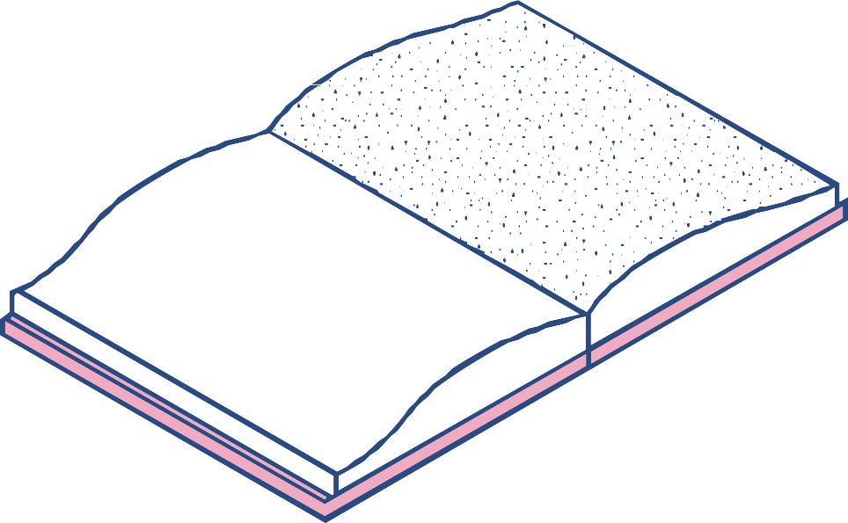
Project 2
AP Morgan Data Platform
AP Morgan Online is all about registering or valuing our property and this can be done on any day at any time. You need not wait to book an appointment with the manager and then update him later after your valuation had been done. It is as simple as you can imagine.

Slide 16
What is Project 2 About?
Everyday, we will be getting loads and loads of data. But, it is all in CSV format. Usually, in Azure we are going to store it in the Azure Data Lake Storage.
To perform Analytics on this, we need to use Azure Data Bricks.
So basically here, we are storing the CSV data available with us in the delta table created using Data Brick. This whole data is being accessed from a cloud storage space.

Slide 17
CSV Data | Azure Data Lake | Azure Data Bricks
CSV or Comma Separated Values is a tabular data which has been saved as a plain text data that has been separated by commas. | Azure Data Lake is a storage solution based on the Azure Storage Platform. It is an on-demand Analytics job service. | Azure Databricks can be used to read data from various sources available in various formats to perform analytics and create databases.

Slide 18
What do we need to do in this Project ?
1
2
3
4
5
S T E P
S T E P
S T E P
S T E P
S T E P
Create Azure Databricks
Creating a cluster in the databricks
Adding a notebook in Databricks and implementing BI
Creating Azure Data Factory
Creating azure data bricks linked service in azure data factory

Slide 19
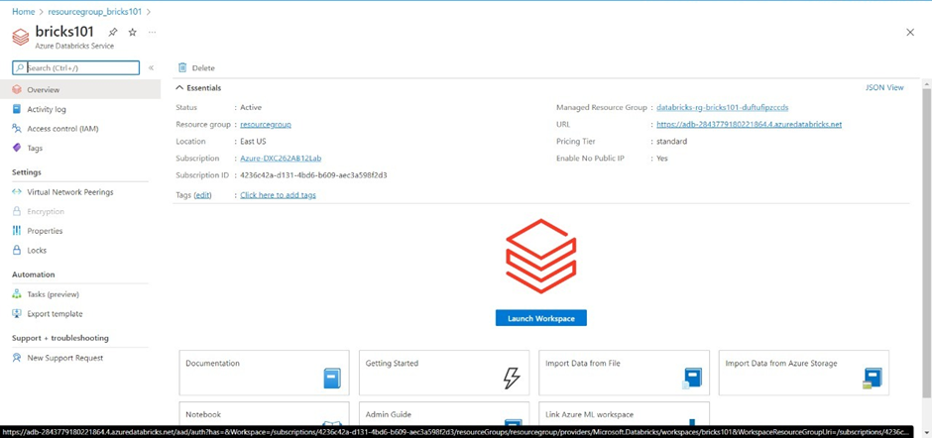
First Create an Azure Databricks Workspace

Slide 20
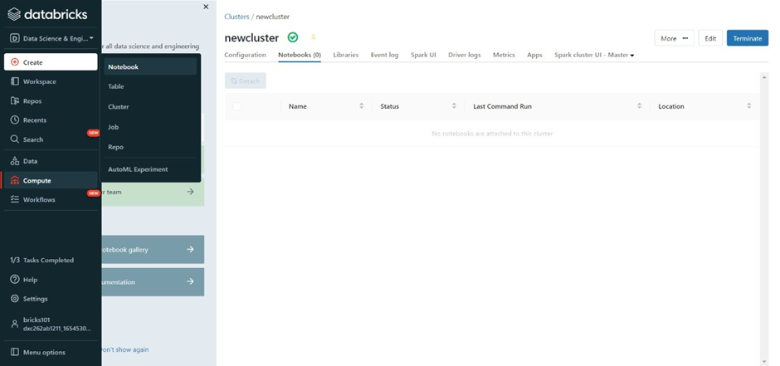
Now, create a Cluster

Slide 21
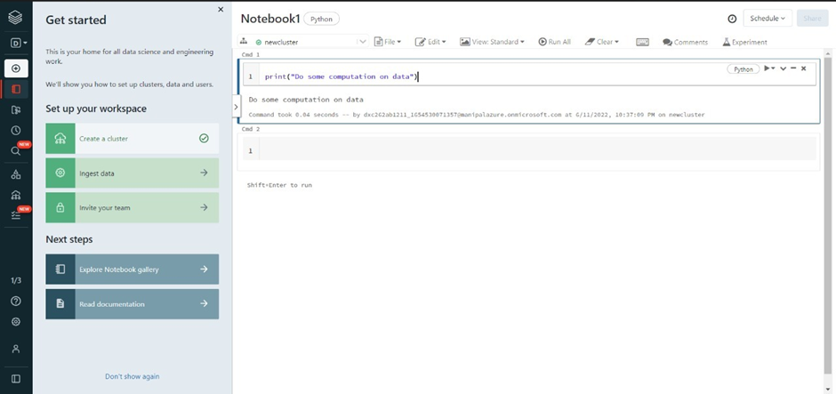
After creating the cluster, create a notebook to work on or computing any code

Slide 22
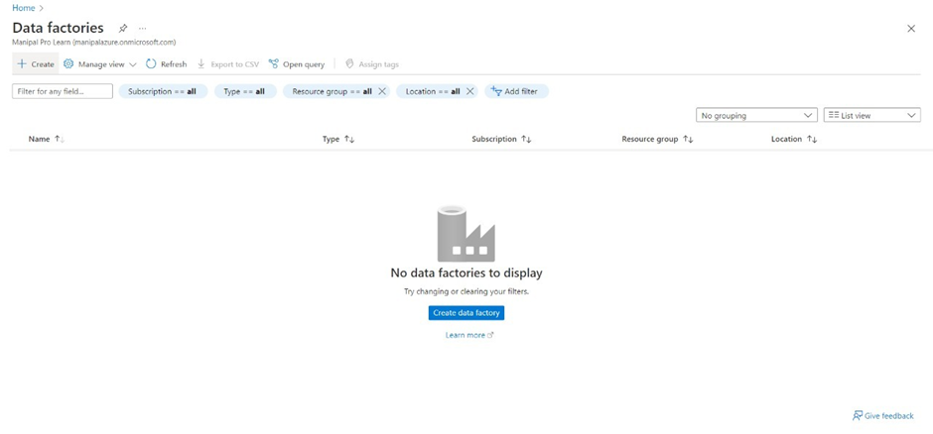
Now, Create Azure Data Factory

Slide 23
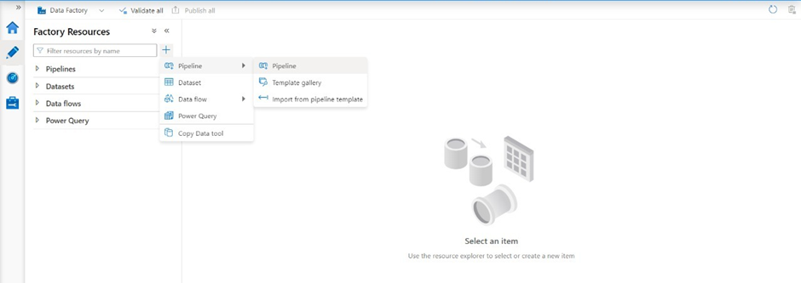
Create a pipeline that will connect Databricks notebook with Data Factory

Slide 24
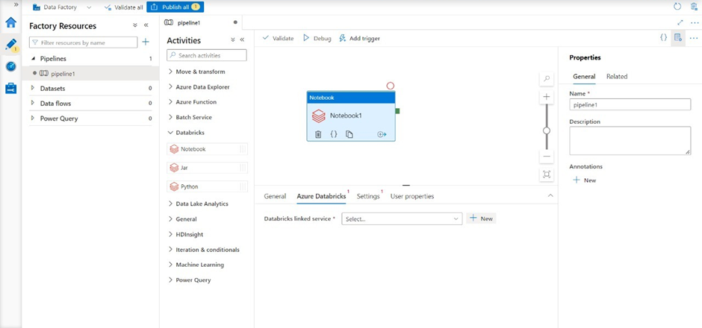
Create a new pipeline and Drag and Drop the notebook tab from Azure Databricks. Dropdown into the pipeline workspace

Slide 25
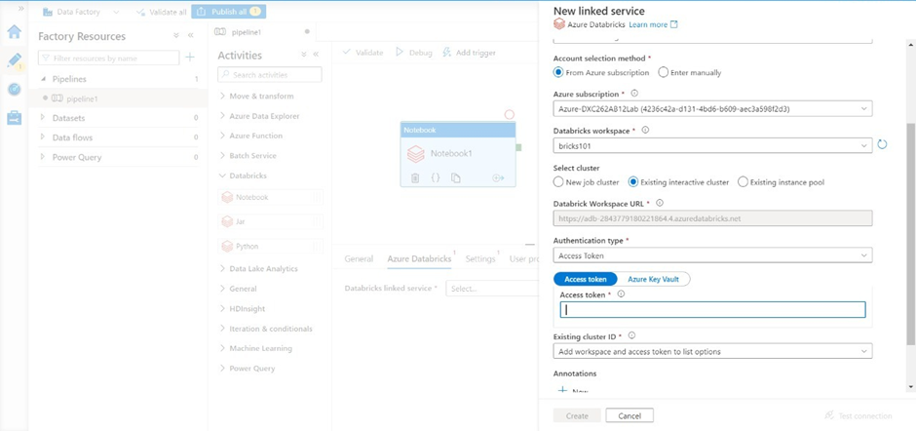
Create a new linked service for Databricks

Slide 26
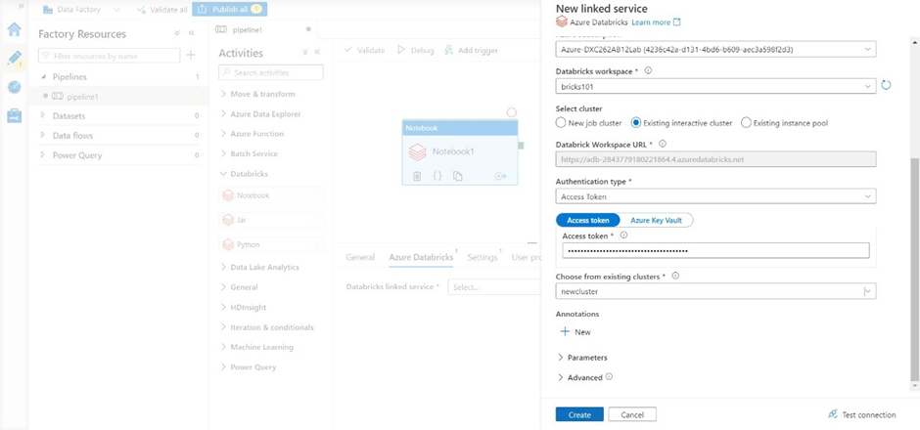
We need the access token of Databricks account in order to access it. Navigate to Databricks workspace and go to Users in settings. Click on “Generate token” and mention a small quick description name for the token. After that a tab will open containing your access token, copy it and paste it in the azure factory data connection form

Slide 27
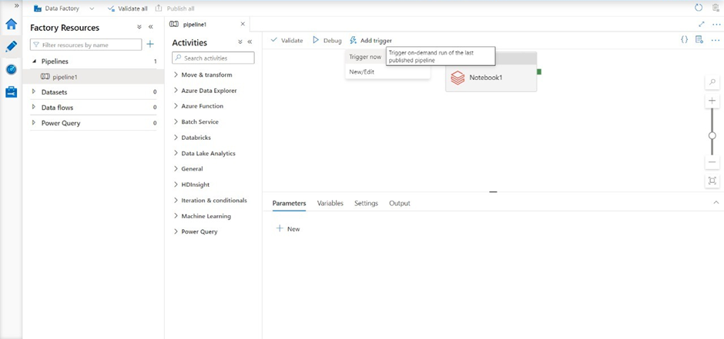
Now choose the notebook in the pipeline notebook tab setting to trigger it. Publish the pipeline to trigger it, after the publication is done, click on “Trigger now”

Slide 28
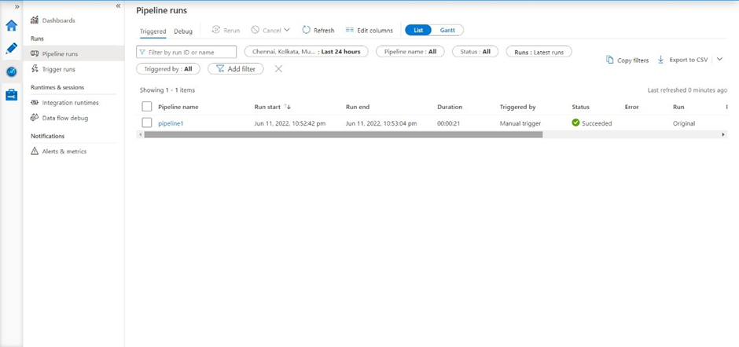
Result: Successfully able to link and trigger Azure DataBricks notebook using Data Factory.

Slide 29
Conclusion
Using Data Factory, we successfully linked and triggered an Azure DataBricks notebook.
Azure Data Factory and Azure Data Bricks are linked.

Slide 30

Industry Applications of the Project:
AP Morgan Estate Agents
Sell Property
Buy Property
Review Property

Slide 31
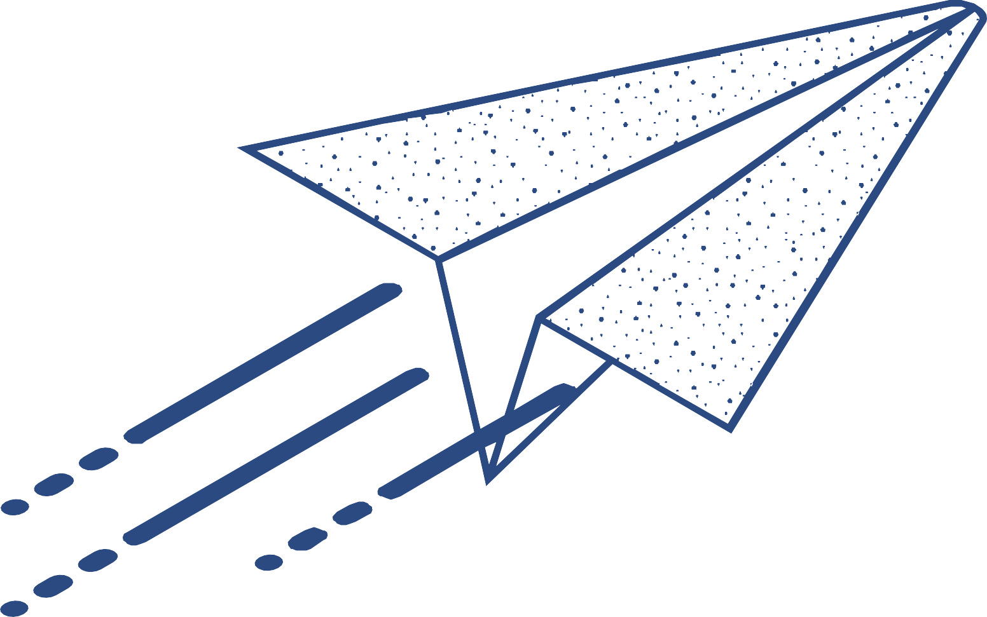






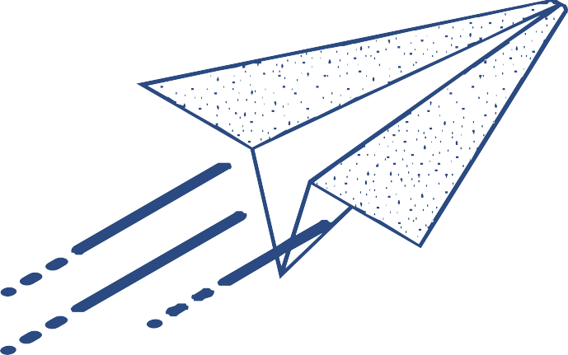


















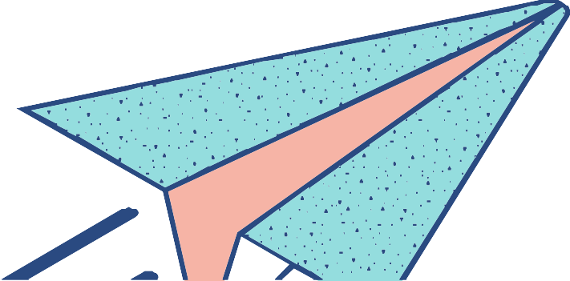
Thank You

